Slide 1
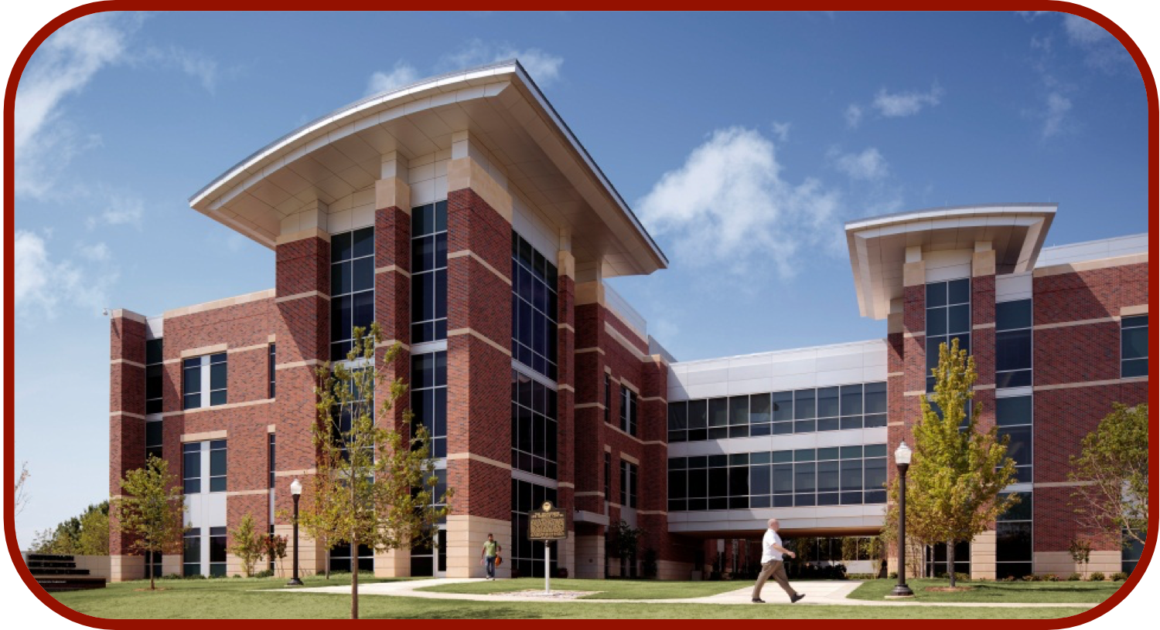
AlphaFold and Protein Structure Prediction
CCATS Group

Slide 2
Timeline
Walker, Yallapragada, and Tangney, Trends in Biotechnology, 2020, 39, P651

Slide 3
Protein Structure Prediction vs Protein Folding
It is a much harder task to identify the protein folding pathway
Cyrus Levinthal’s Paradox
A protein with 150 amino acids, 298 dihedral angles
If each angle can adopt one of three stable conformations, there are 3²⁹⁸~10¹⁴⁹ possible configurations
If the protein randomly samples the configurations at a rate of 10¹² configurations per second, it would take the age of the universe for this protein to fold
God does not play dice with the universe
https://web.archive.org/web/20110523080407/http://www-miller.ch.cam.ac.uk/levinthal/levinthal.html
Levinthal, Ext. du J. Chim. Phys. 1965, 65, 44

Slide 4
Protein Folding Pathway
Wolynes, Onuchic, Thirumalai, Science, 1995, 267, 1619; Dill and Chan, Nature Struct. Biol. 1997, 4, 10
Englander and Mayne, Proc. Natl. Acad. Sci. USA, 2014, 111, 15873

Slide 5
CASP14
Critical Assessment of Structure Prediction (CASP)
Test systems: 52 proteins or protein complexes. 42 (x-ray), 7 (cryo-EM), 3 (NMR)
Participants: 97 research groups (19 countries), 215 modeling methods
Global Distance Test Total Score (GDT_TS) through Local-Global Alignment
Zelma, Nuc. Acids Res. 2003, 31, 3370
Measures the similarity between structures of the same protein
Kryshtafovych, Schwede, Topf, Fidelis, and Moult, Proteins, 2021, 89, 1607

Slide 6
CASP14
Kryshtafovych, Schwede, Topf, Fidelis, and Moult, Proteins, 2021, 89, 1607

Slide 7
AlphaFold2 Results From CASP14
T1053, bacterial kinase
Jumper, Evans, .., Hassabis, Proteins, 2021, 89, 1711

Slide 8
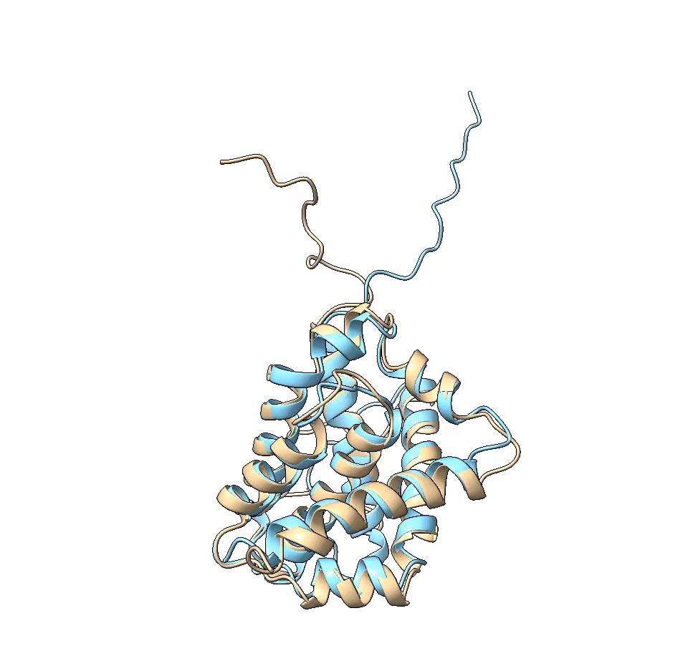
AlphaFold Tutorial
Goals:
Predict the structure of Bax
Predict the complex of PaParDE (Bourne Lab)
The working directory I prepared is organized as follow:
> /home/van/MacroMol_Modelling_Tutorial/02_AlphaFold/
> Results/
> Tutorial/
> 00_monomer_pred/
> monomer.slurm
> 01_complex_pred/
> complex.slurm
>
>
>
>
NMR Structure (PDB 1F16)
AlphaFold Prediction

Slide 9
AlphaFold Workflow
Input
Amino acid Sequence (FASTA format)
AlphaFold Program
Conda environment (contains dependencies; ~ 2.2 GB)
AlphaFold Software (~14 MB)
AlphaFold Databases (~2.2 TB)
BDF, MGnify, PDB70, PDB MMCIF, PDB SEQRES, Uniclust30, Uniprot, Uniref90
GPU (not required, but strongly encouraged)
Set a max template date
If all goes well, you get 5 to 25 predicted structures!

Slide 10
FASTA Files
FASTA means “FAST All,” which is an extension from the previous “FAST-N” or “FAST-P”
Format originated from FASTA Program for sequence alignments (1985)
Now the universal standard for bioinformatic tools (BLAST, CLUSTAL, etc.)
First line contains “>” which denotes a comment
Formally, this line also contain descriptions such as:
UNIPROT entry, Gene Identity, Organism, Accession Numbers, etc.
Next line contains one letter code of nucleotide or amino acid sequence
AA sequence for AlphaFold!
Usually 80 characters/line
Each sequence is followed by an empty line for multiple sequences.

Slide 11
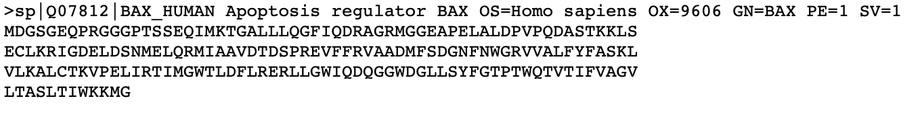
FASTA Files
Example Bax UNIPROT Data:
https://www.uniprot.org/uniprotkb/Q07812
https://rest.uniprot.org/uniprotkb/Q07812.fasta
UniProtKB/Swiss-Prot
Entry Name
organism name
gene name
sequence version
Unique Identifier
Protein Name
organism identifier
protein existence
amino acid sequence
80 characters/line

Slide 12
AlphaFold Program on OSCER
Skip this slide unless you want to install your own AlphaFold program.
https://github.com/deepmind/AlphaFold
Installation: 1) NVIDIA Container Toolkit, and 2) Docker file (cannot do this as normal user)
My workaround:
Conda environment (Contains NVIDIA Toolkit, Tensorflow, OpenMM, HHsuite, etc.)
Anaconda/Miniconda for package management (conda activate af2.2.0)
Download my own copy of AlphaFold (/home/van/Programs/AlphaFold)
Database for AlphaFold is stored on OSCER
Half of the database is stored in: /opt/oscer/software/AlphaFold/2.0.0
Other half requires periodic updates which is automated in: /data/AlphaFold (done at the beginning of every month)

Slide 13
AlphaFold Databases
BDF
Clustered protein sequences (MSA)
MGnify
Genetic microbiome data (MSA)
PDB70
Sequence for HHsuite (MSA)
PDB MMCIF
MMCIF files from RCSB
PDB SEQRES
RCSB data for complex prediction
Uniclust30
Clustered sequences based on 30% pairwise identity
Uniprot
Gene data for complex prediction
Uniref90
Clustered sequences from Uniref100 database (sequences shorter than 11 have 1 representative member here)

Slide 14
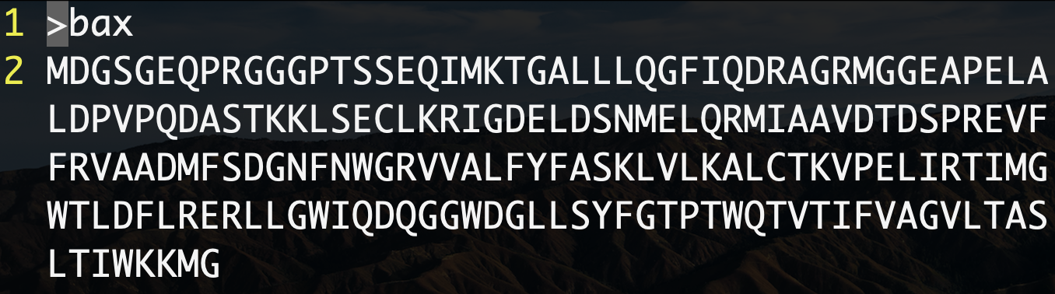
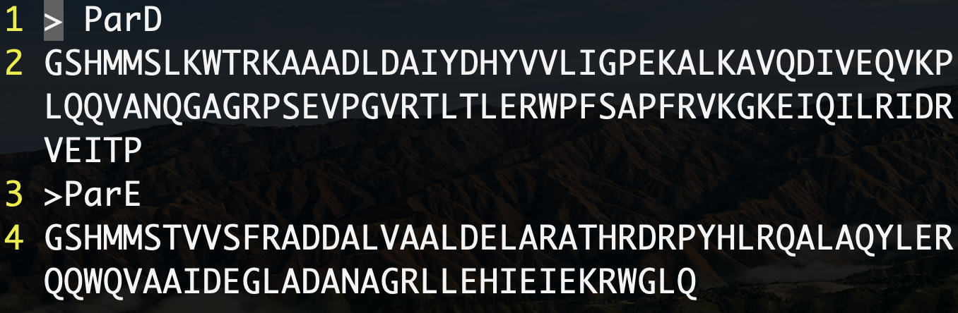
Differences for Monomer v. Complex Prediction
Input File
(Amino Acid Sequence(s) in FASTA format)
Example:
Monomer FASTA
$ vi monomer.fasta
1 | > name_1
2 | [amino acid sequence 1]
$ vi complex.fasta
1 | > name_1
2 | [amino acid sequence 1]
3 | > name_2
4 | [amino acid sequence 2]
.. | …
Complex FASTA (PaParDE - Bourne Lab)

Slide 15
Differences for Monomer v. Complex Prediction
AlphaFold Databases
Monomer Prediction Database
Complex Prediction Database
BFD
MGnify
PDB MMCIF
PDB70
Uniclust30
Uniref90
—
—
BFD
MGnify
PDB MMCIF
—
Uniclust30
Uniref90
PDB SEQRES
UNIPROT

Slide 16
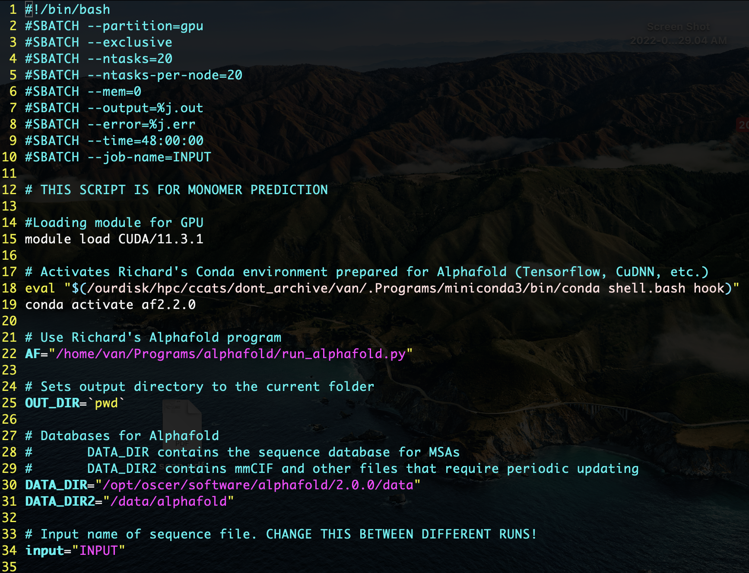
Tutorial/00_monomer_pred/monomer.slurm (First 35 Lines)
SLURM Allocation requests
Rename INPUT to job name
Load CUDA library (for GPU)
Loads my conda environment for AlphaFold
Variable “AF” points to AlphaFold program
Variable “OUT_DIR” points to current working directory
Variable “DATA_DIR” points to AF databases
Variable “DATA_DIR2” points to AF databases that update at the beginning of every month
Variable “input” is the name of your fasta file (rename INPUT)

Slide 17
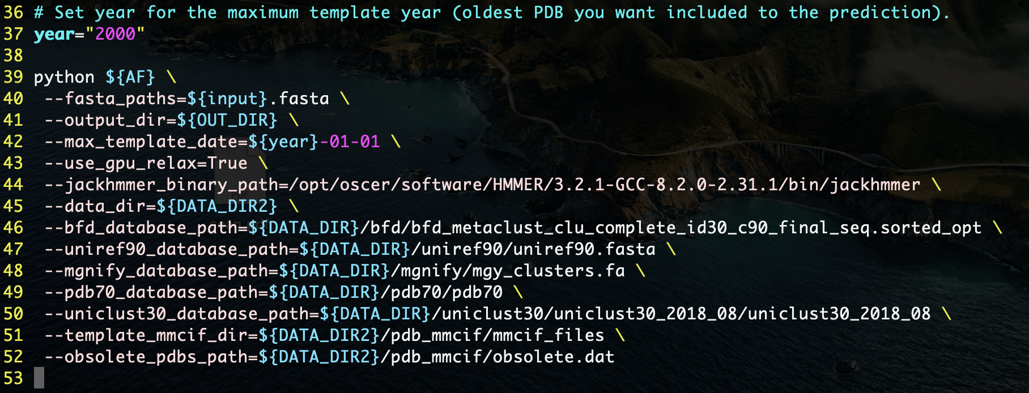
Tutorial/00_monomer_pred/monomer.slurm (Lines 35 to EOF)
fasta_paths
Input sequence (e.g. bax.fasta)
output_dir
Predictions are saved to output
directory in this directory
max_template_date
For PDB search
use_gpu_relax
Use GPU acceleratedminimization
jackhmmer_binary_path
Points to jackhammer program
(probably not needed anymore)
The rest are flags pointing to the
appropriate databases.
Max template year for PDBS
* The symbol “\” means continue reading next line (ignores line breaks)

Slide 18
Monomer Tutorial (~2.75 hours, node: c301)
Make input file:
$ vi bax.fasta
>bax
MDGSGEQPRGGGPTSSEQIMKTGALLLQGFIQDRAGRMGGEAPELALDPVPQDASTKKLSECLKRIGDELDSNMELQRMIAAVDTDSPREVFFRVAADMFSDGNFNWGRVVALFYFASKLVLKALCTKVPELIRTIMGWTLDFLRERLLGWIQDQGGWDGLLSYFGTPTWQTVTIFVAGVLTASLTIWKKMG
Change INPUT to bax in monomer.slurm (lines 10 & 34)
sed -i ‘s/INPUT/bax/’ monomer.slurm
Submit the SLURM script
sbatch monomer.slurm

Slide 19
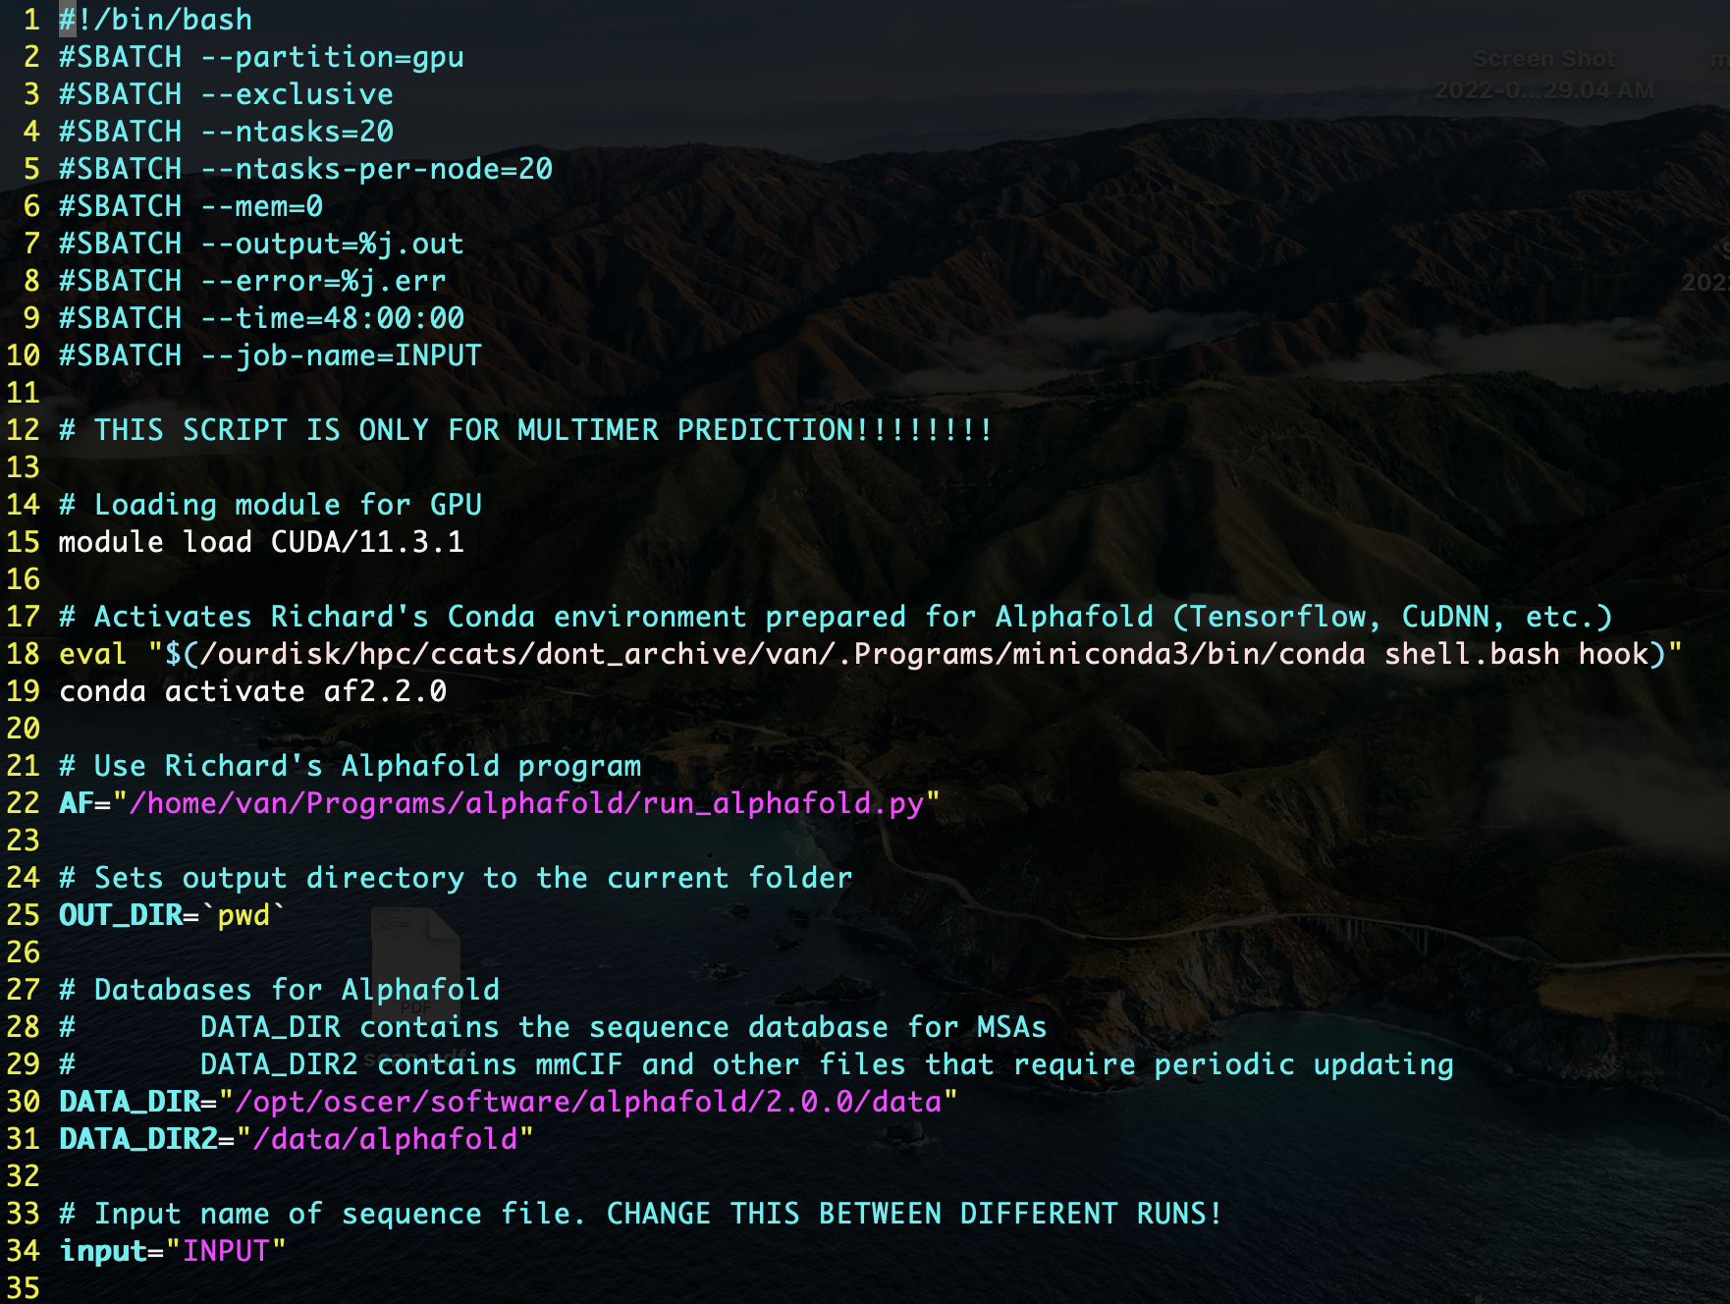
Tutorial/01_complex_pred/complex.slurm (First 35 Lines)
SLURM Allocation requests
Rename INPUT to job name
Same as monomer.sh so far..
(Except for comment on line 12)
Load CUDA library (for GPU)
Loads my conda environment for AlphaFold
Variable “AF” points to AlphaFold program
Variable “OUT_DIR” points to current working directory
Variable “DATA_DIR” points to AF databases
Variable “DATA_DIR2” points to AF databases that update the beginning of every month
Variable “input” is the name of your pasta file (rename INPUT)

Slide 20
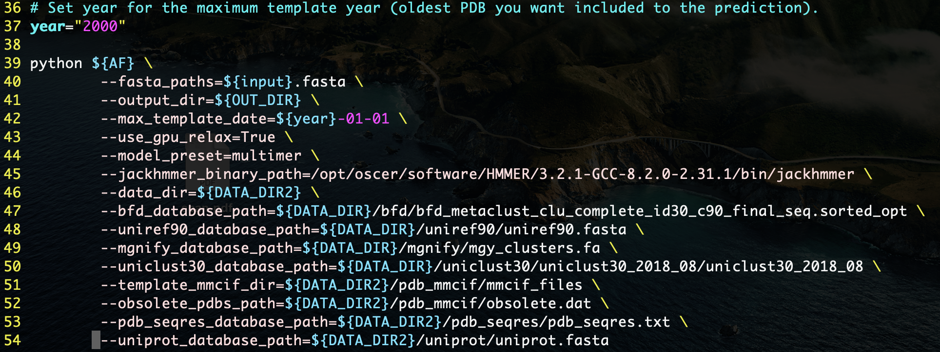
Tutorial/01_complex_pred/complex.slurm (Lines 35 to EOF)
Max template year for PDBS
All flags are the same as
monomer.slurm
Differences are in lines 53, 54,
and removed the PDB70
database
* The symbol “\” means continue reading next line (ignores line breaks)

Slide 21
Complex Tutorial
Make input file:
$ vi paparde.fasta
> ParD
GSHMMSLKWTRKAAADLDAIYDHYVVLIGPEKALKAVQDIVEQVKPLQQVANQGAGRPSEVPGVRTLTLERWPFSAPFRVKGKEIQILRIDRVEITP
>ParE
GSHMMSTVVSFRADDALVAALDELARATHRDRPYHLRQALAQYLERQQWQVAAIDEGLADANAGRLLEHIEIEKRWGLQ
Change INPUT to paparde to complex.slurm (lines 10 & 34)
sed -i ‘s/INPUT/paparde/’ complex.slurm
Submit the SLURM script
sbatch complex.slurm

Slide 22
SLURM Commands
sbatch [file.slurm] ; Submits SLURM script to scheduler
squeue ; Check the SLURM queue
squeue -u [username] ; Check your SLURM queue
squeue -p [partition] ; Check the queue for a specific partition
scancel [job number] ; Cancel a submitted job

Slide 23
SLURM Commands
module load [name] ; Loads the environment for specified program
module purge ; Cleans loaded modules
module list ; List all currently loaded modules
module avail ; List all available modules
module spider [name] ; Searches for program
Alternatively, you can look for software in: /opt/oscer/software

